Slide 1

Skyguard: Flight Crash Forecast

Slide 2





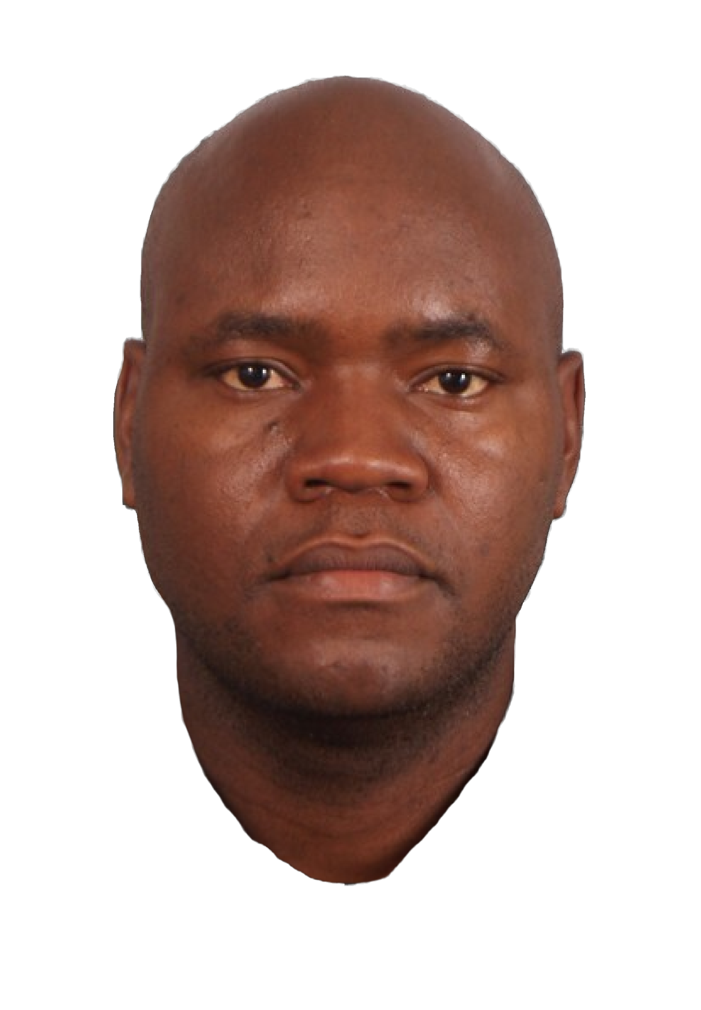


Flight attendants
Diana Tarasovets
Experience: 9 years with United Airlines

Slide 3
Flight attendants
Kimberly Bonilla
Experience: 1 year with United Airlines

Slide 4
Flight attendants
Maero Lutta
Experience: 5 years with United Airlines

Slide 5
Flight attendants
Captain Perez
No experience. But hey,
when life hands him
turbulence, he grabs the
microphone and makes it a
comedy show!

Slide 6
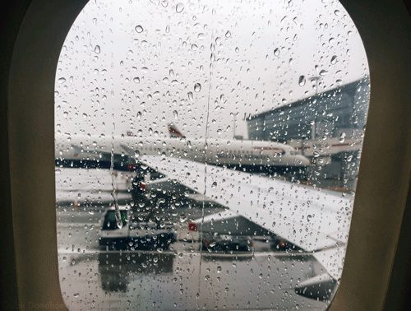

Slide 7
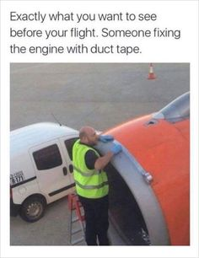
Don’t worry Folks this never happens on United Airlines

Slide 8
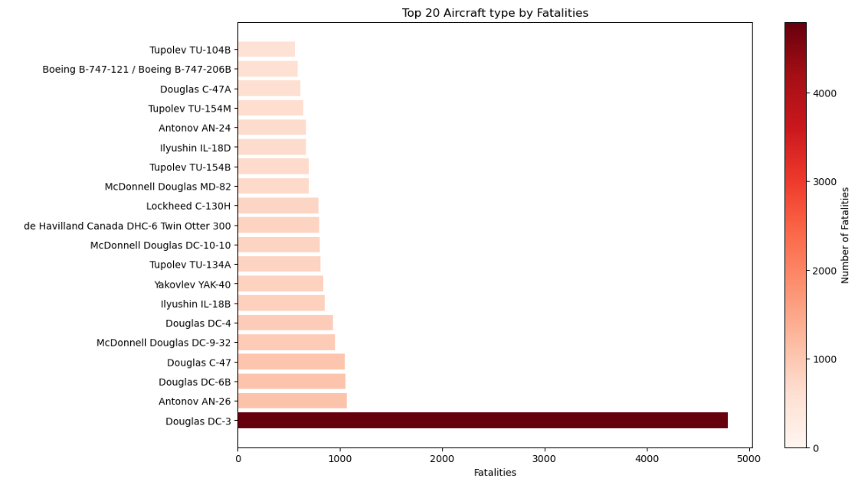
Aircraft type by fatalities

Slide 9
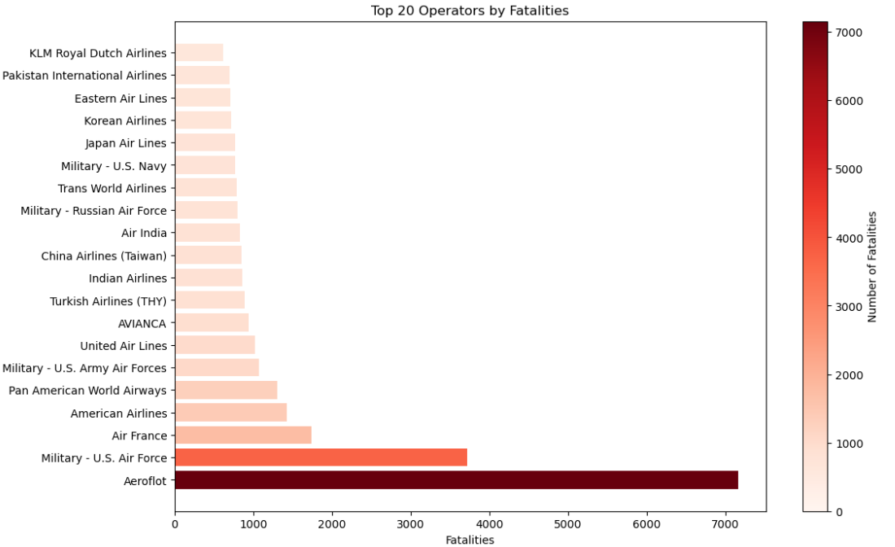
Fatalities per operator
Aeroflot: Is a Russian Airline

Slide 10
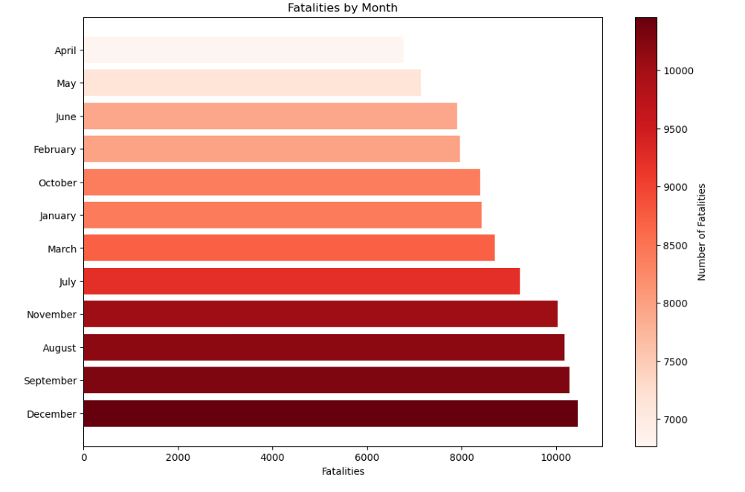
Fatalities by month

Slide 11
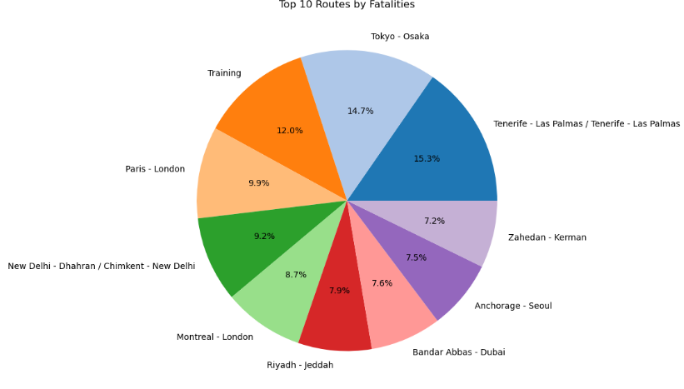
Top 10 routes by fatalities

Slide 12
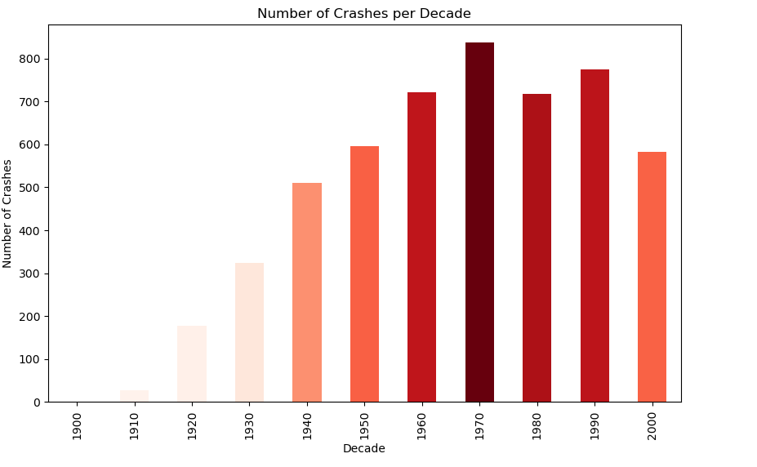
Number of crashes per decade

Slide 13
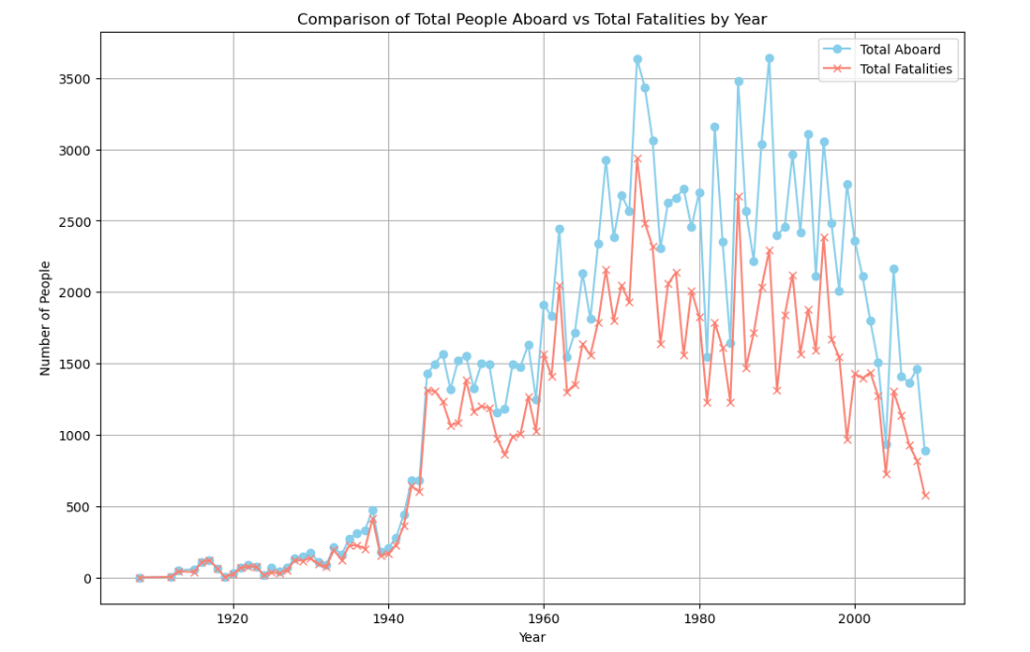
Total aboard vs total fatalities

Slide 14
LIMITATIONS
Data accessibility: Access to comprehensive aviation crash data can be restricted due to confidentiality concerns, national security issues, or proprietary information held by airlines
We encountered challenges within our dataset, particularly with entries from certain states in the United States lacking country designation. This lack of clarity significantly impeded our ability to accurately depict the global distribution of aviation incidents on a world map.

Slide 15
NEXT STEPS
Data Refinement: Allocate time to gather more comprehensive and diverse datasets related to aviation incidents, including historical crash data, weather patterns, aircraft performance metrics, pilot records, and air traffic data. Enhance data cleaning and preprocessing techniques to ensure high quality and consistency.
Feature Engineering: Invest efforts into feature engineering to extract meaningful features from raw data. Explore advanced techniques such as dimensionality reduction, time-series analysis, and anomaly detection to uncover hidden patterns and insights that can improve predictive performance.

Slide 16
THANK YOU!!

